Slide 1
Abraham Kuyper as Publisher
Analyzing the Finances of De Heraut and De Standaard
Clifford B. Anderson Director for Scholarly Communications Vanderbilt University
@andersoncliffb

Slide 2
Historical Sketch
Abraham Kuyper as Publisher

Slide 3
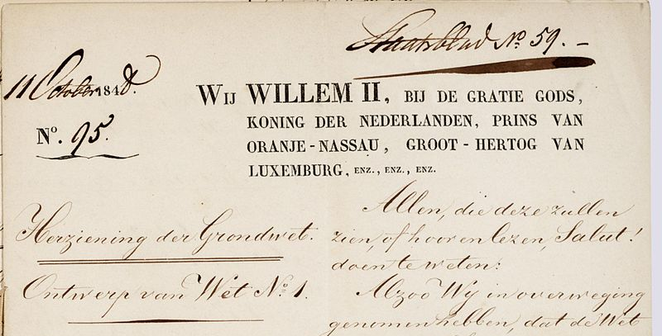
Dutch Constitution of 1848
Notes:
Source: https://nl.wikipedia.org/wiki/Grondwetsherziening_van_1848#/media/File:Grondwet_1848_Nl-HaNA_2.02.04_514_01.jpg

Slide 4
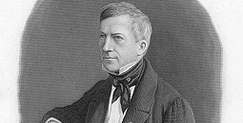
Anti-Revolutionaries
Notes:
Source: http://www.dbnl.org/auteurs/index.php?c=19&l=G

Slide 5
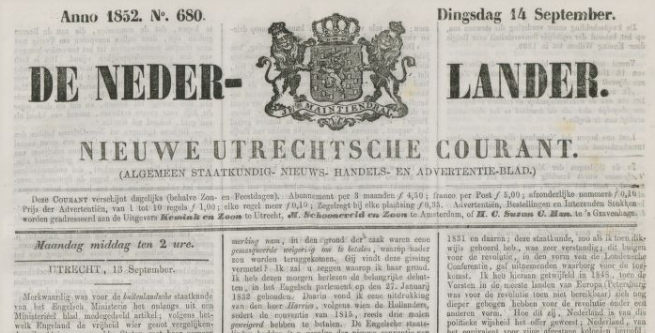
De Nederlander
Notes:
Source: http://www.theeuropeanlibrary.org/tel4/newspapers/issue/fullscreen/3000112843225
Circulation: 350 (21 aug. 1848-29 juni 1850 (nr. 1-nr. 572) en 1 juli 1850-30 juni 1855 (nr. 1-nr. 1539): See http://www.hdc.vu.nl/nl/Images/Nederlander,Nieuwe_Utrechtsche_Courant_tcm215-132417.pdf

Slide 6
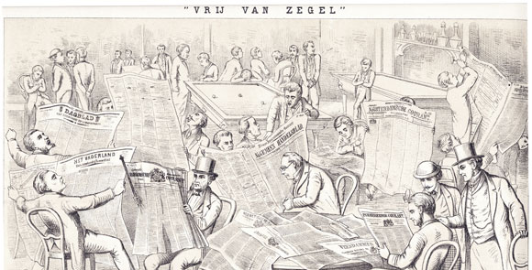
Abolition of the Stamp Tax
Notes:
Abolition of Dagbladzegel on 1 July 1869; Source: http://www.iisg.nl/exhibitions/censorship/pm3966.php

Slide 7
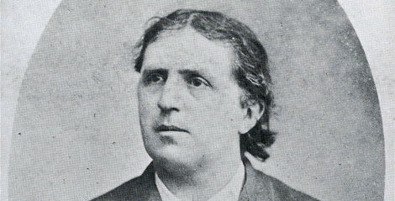
Abraham Kuyper
Notes:
Source: http://www.npogeschiedenis.nl/speeches/nederlandsespeeches/koninkrijk-der-nederlanden/Toespraak-Abraham-Kuyper-tijdens-het-Congres-van-kerkelijke-ambtdragers-en-gemeenteleden-.html

Slide 8
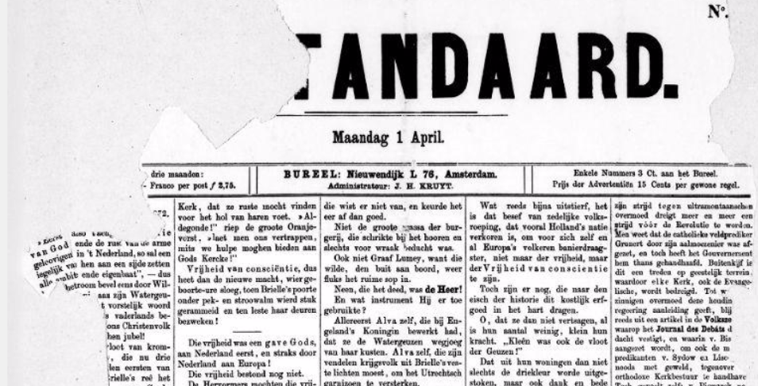
De Standaard
Notes:
Source: http://www.delpher.nl/nl/kranten/view?coll=ddd&cql%5B%5D=%28date+_gte_+%2201-04-1872%22%29&cql%5B%5D=%28date+_lte_+%2205-04-1872%22%29&cql%5B%5D=ppn+any+%28832667536%29&resultscoll=dddtitel&identifier=ddd%3A011065219%3Ampeg21%3Ap001

Slide 9
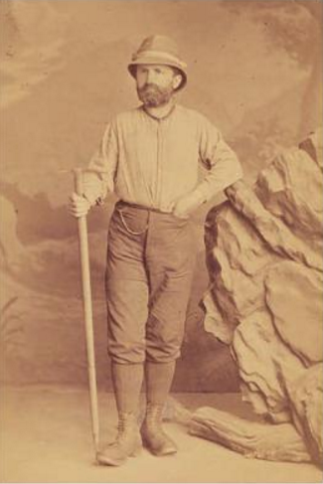
Nervous Collapse
Notes:
February 1876 - April 1877
Source: https://books.google.com/books?id=XUSWAgAAQBAJ&lpg=PA108&ots=aZTM8l2DW4&pg=PA105#v=onepage&q&f=false

Slide 10
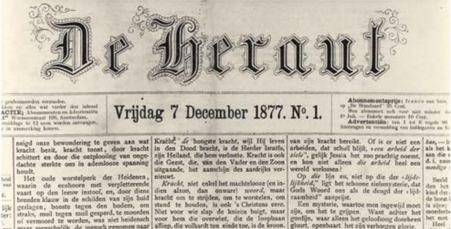
De Heraut
Notes:
Source: https://books.google.com/books?id=XUSWAgAAQBAJ&lpg=PA108&ots=aZTM8l2DW4&dq=kuyper%20heraut%201878&pg=PA108#v=onepage&q=kuyper%20heraut%201878&f=false

Slide 11
Financial Data
Kuyper as Publisher

Slide 12
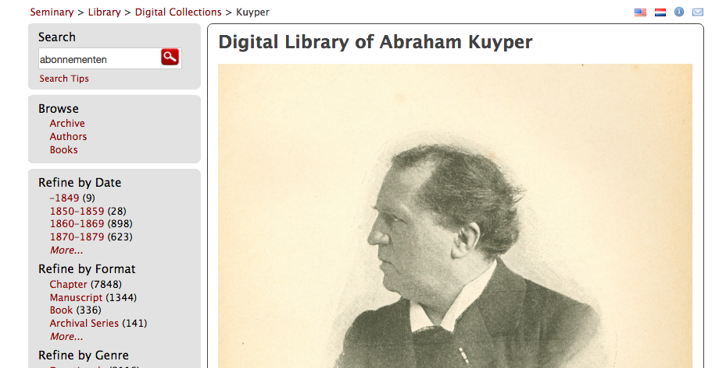
Digital Library of Abraham Kuyper
Notes:
Source: http://kuyper.ptsem.edu/

Slide 13
Research Cycle
Digitization
Encoding
Analysis
Visualization
Aggregation

Slide 14
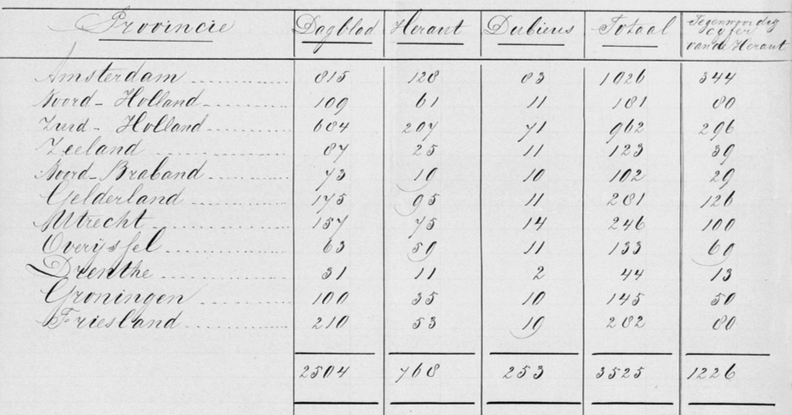
Subscribers (1871)
Notes:
Source: http://kuyper.ptsem.edu/id/Kuyper185-192/dmd019

Slide 15
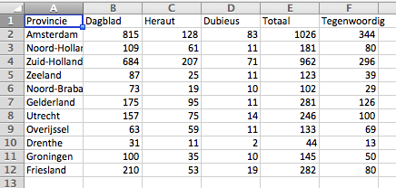
Encoding

Slide 16
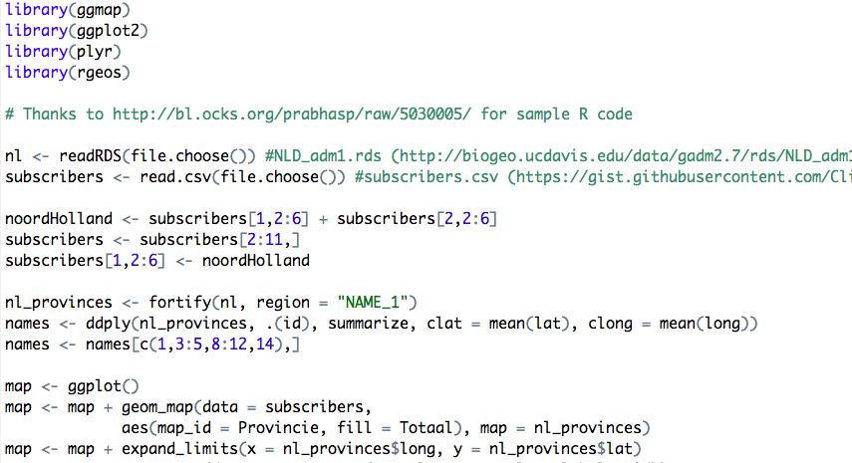
Analysis

Slide 17
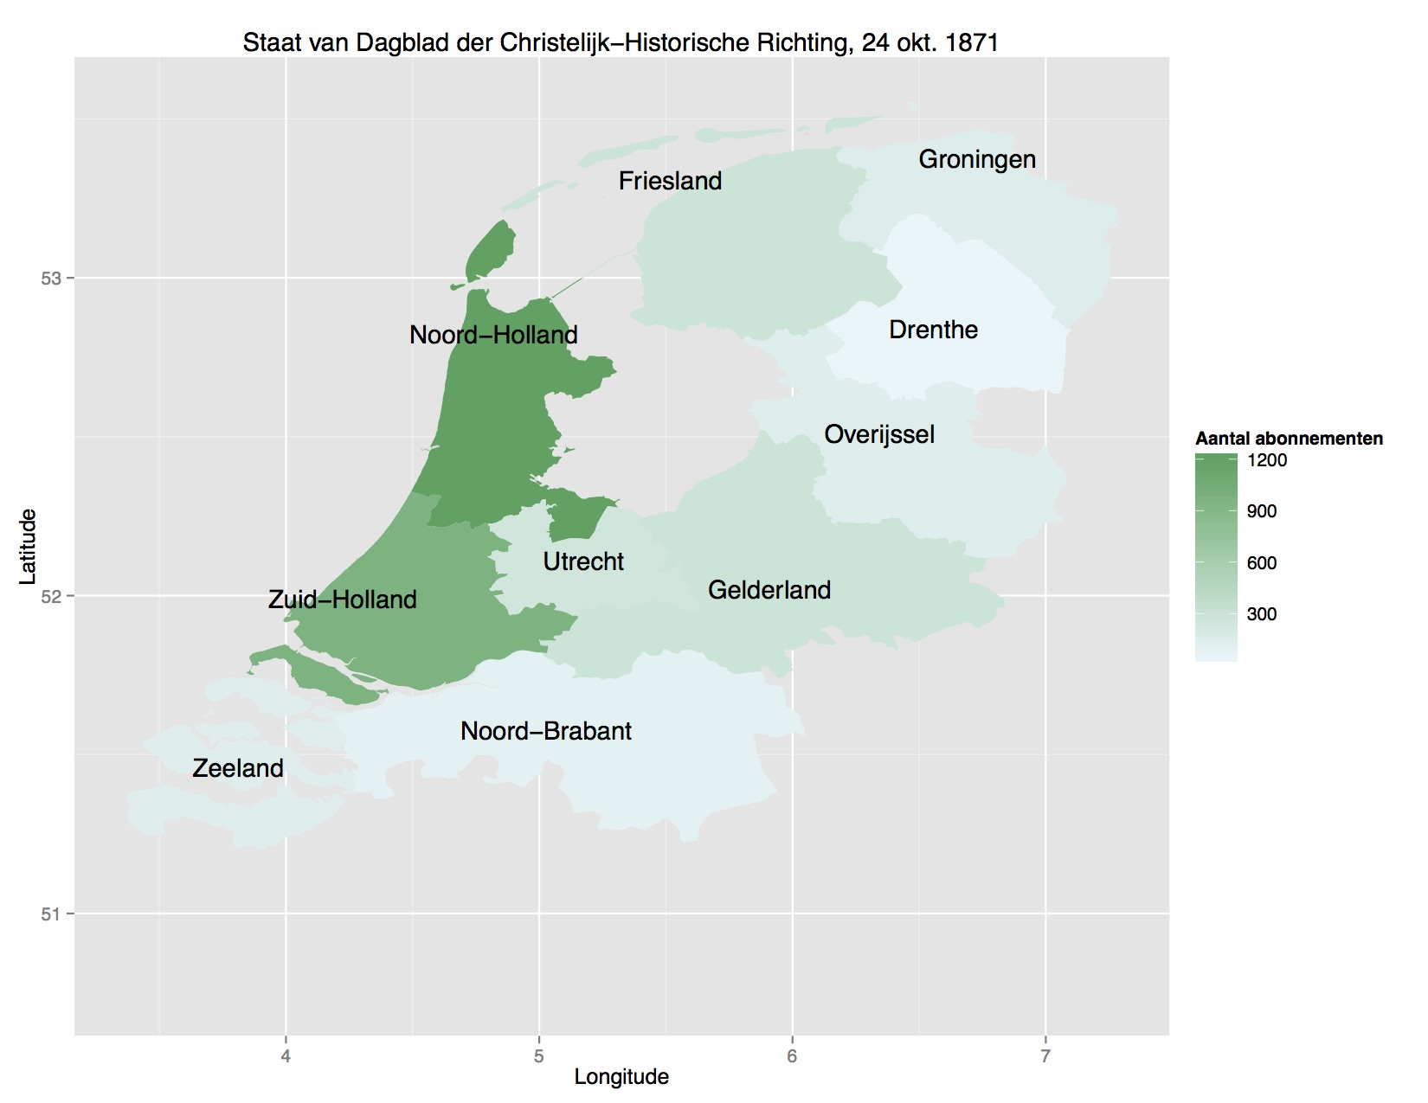
Visualization

Slide 18
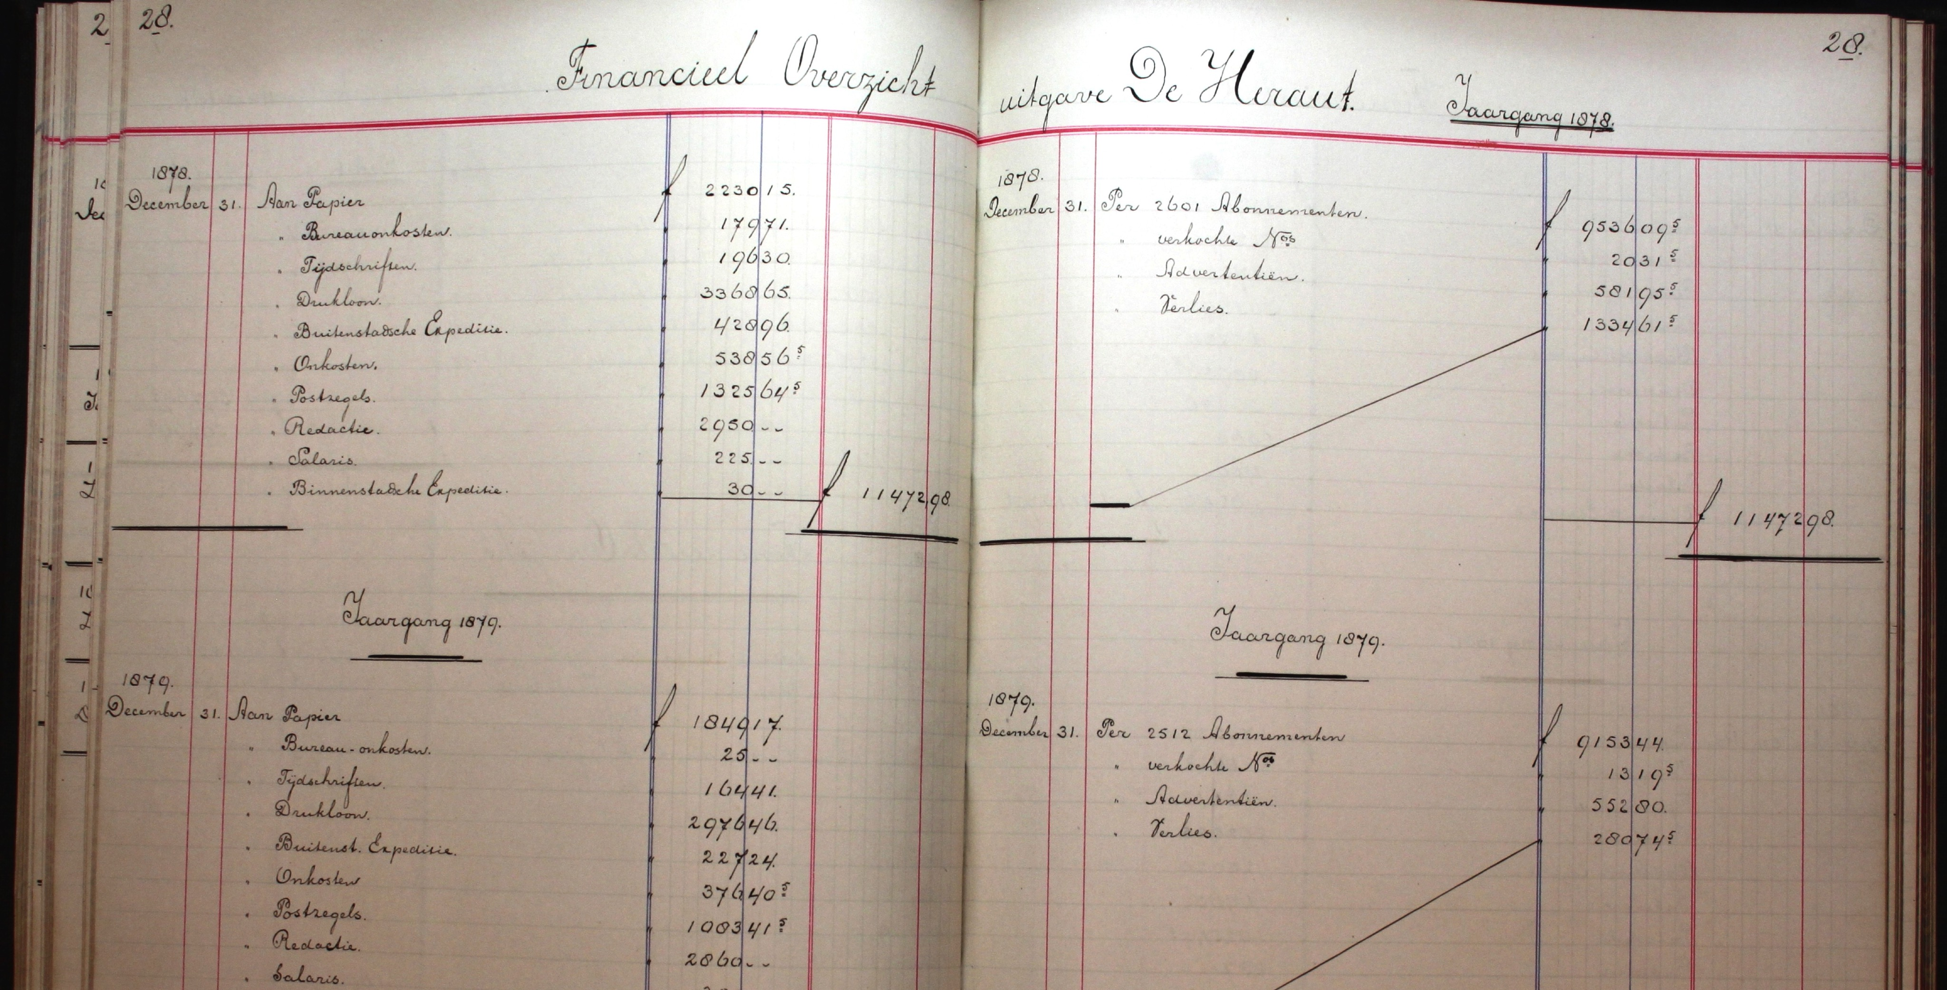
Ledgers of De Heraut
Notes:
Source: Historical Documentation Centre for the History of Dutch Protestantism, Vrije Universiteit Amsterdam

Slide 19
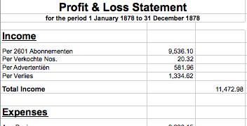
Encoding

Slide 20

Encoding
Notes:
Source: https://en.wikipedia.org/wiki/XBRL#/media/File:XBRL.svg

Slide 21
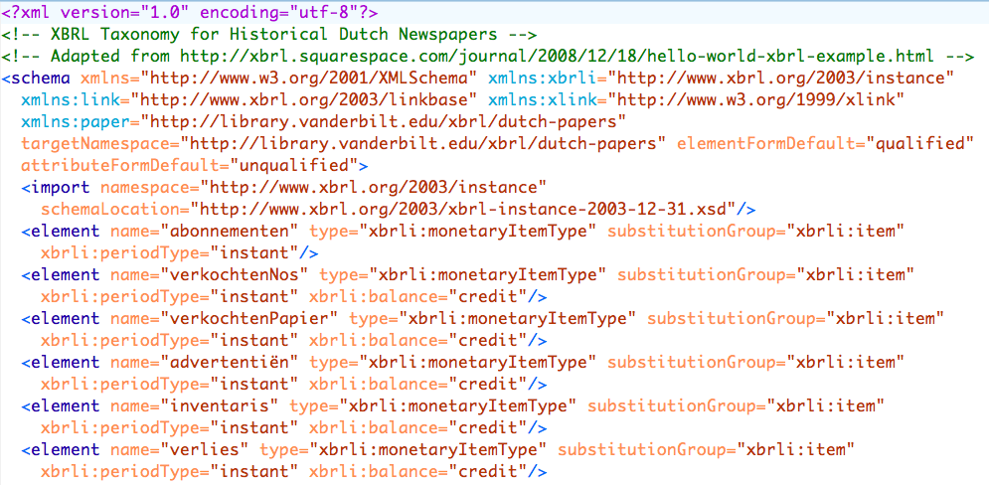
XBRL Taxonomy

Slide 22
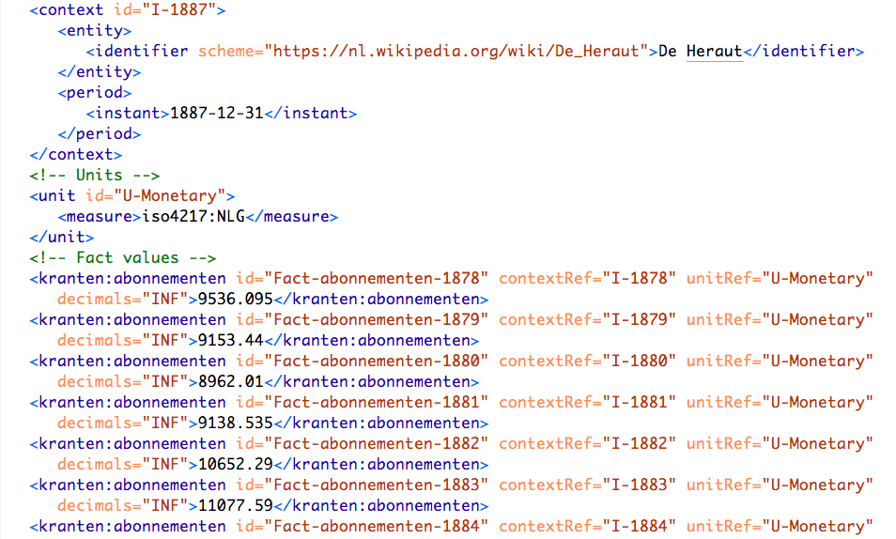
XBRL Instance

Slide 23
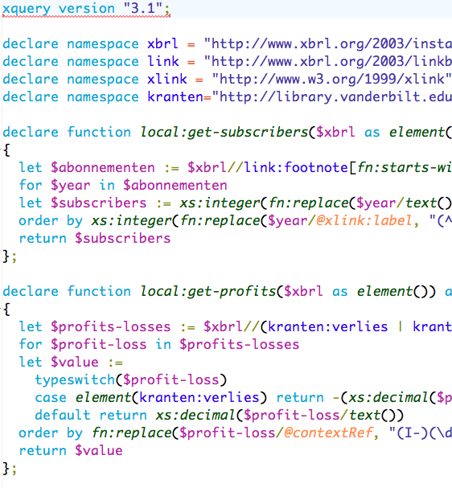
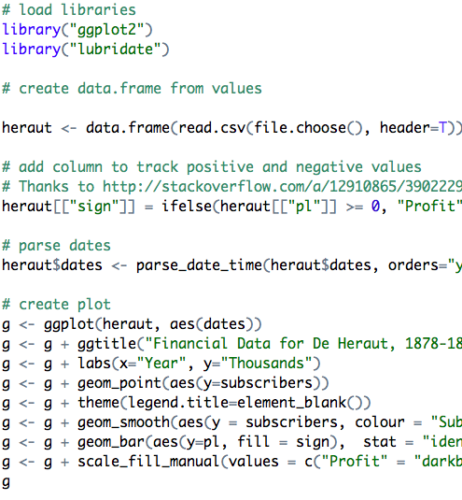
Analysis

Slide 24
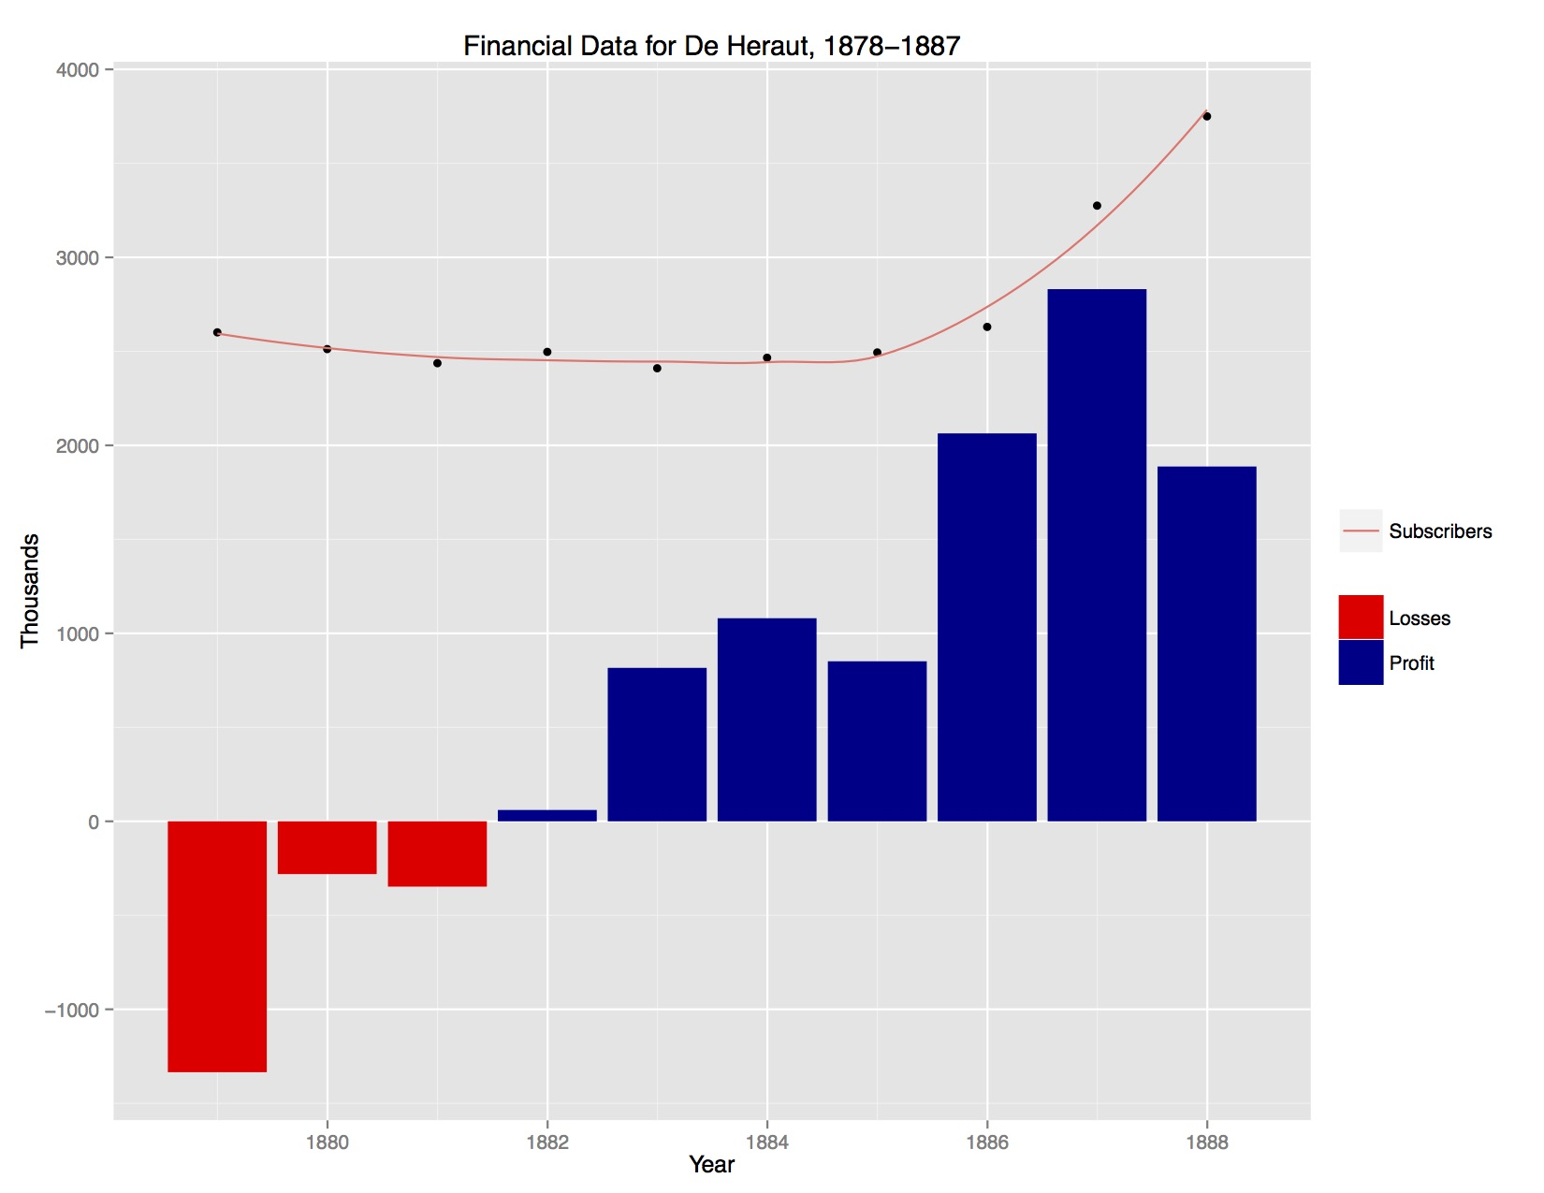
Visualization

Slide 25
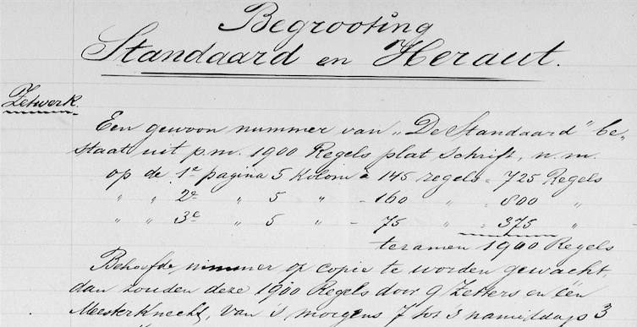
Budget Estimate (1897)
Notes:
Source: http://kuyper.ptsem.edu/id/Kuyper185-192/dmd038

Slide 26
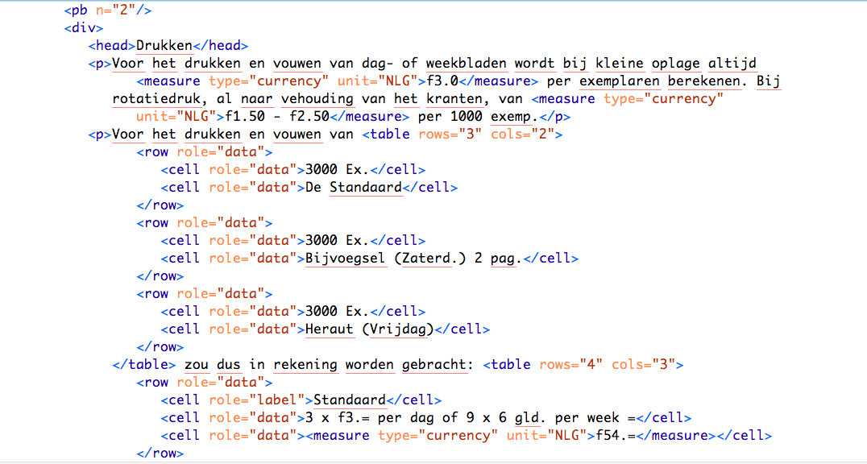
TEI Transcription

Slide 27
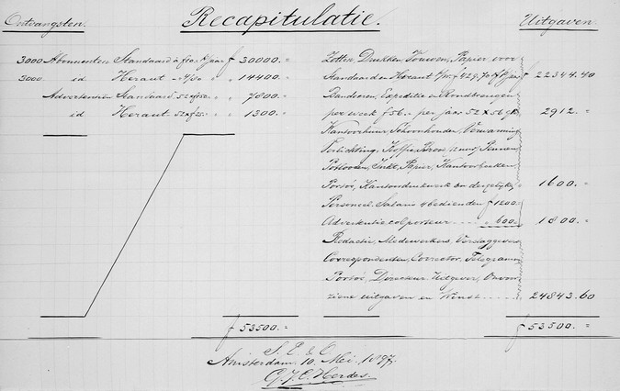
Recapitulation

Slide 28
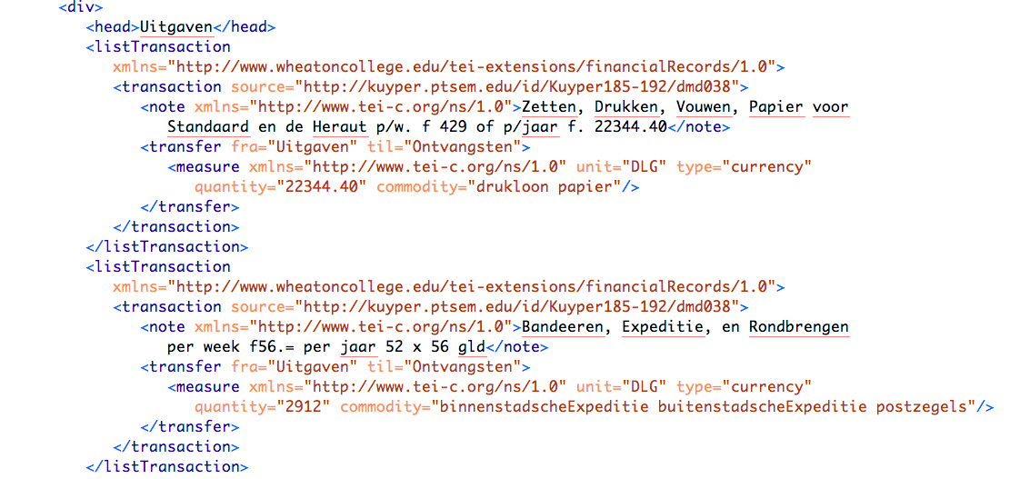
Transactionography

Slide 29
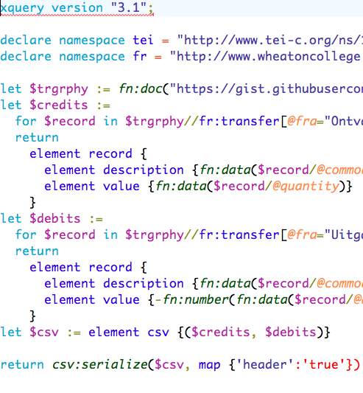
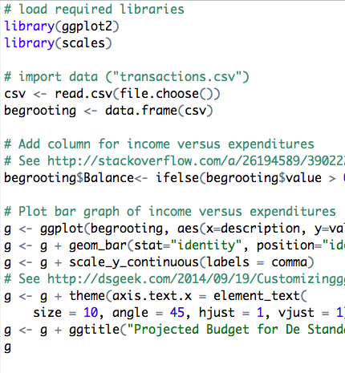
Analysis

Slide 30
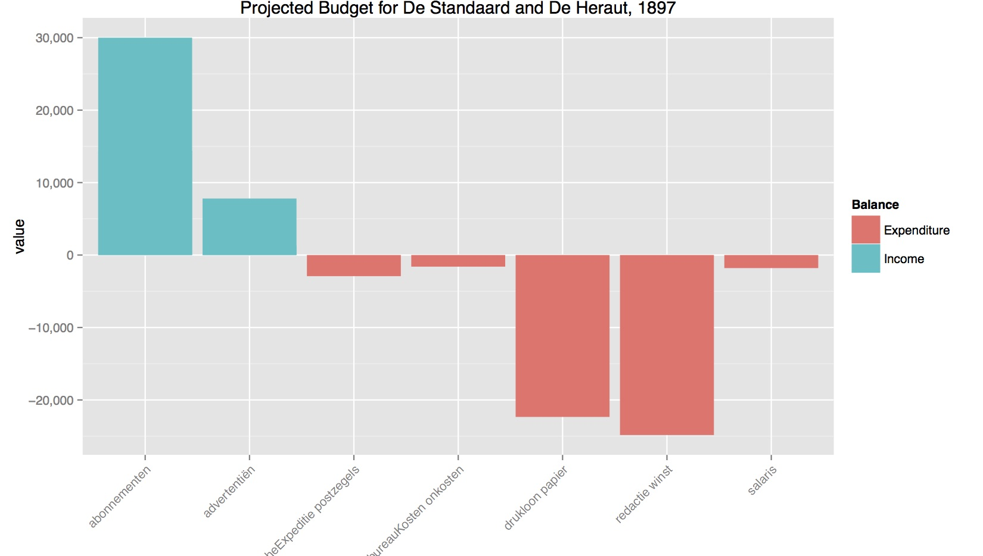
Visualization

Slide 31
Questions
How best to aggregate data from different sources?
What level of data loss is acceptable when encoding historical sources?
Could a shared XBRL taxonomy be developed for (different kinds of) historic financial documents?

